Slide 1
MQTT-CoAP Exercise (Part 1)
Course 34351 Access- and Home Networks

Slide 2
MQTT-CoAP exercise
The MQTT-CoAP exercise is the second of the mandatory exercises in course 34351
Takes place over three consecutive weeks:
Date | Topic
2024-03-07 | Introduction to the exercise, Exercise Part 1 (MQTT)
2024-03-14 | Exercise part 2 (CoAP)
2024-03-21 | Exercise wrap-up if there are parts you’re missing – otherwise work on your journal
2024-04-03 | Deadline for handing-in the journal to the assignment on DTU Learn @23.59

Slide 3
MQTT-CoAP exercise (2)
Hand-in of reports: Individually or in groups of 2 students
Deadline: Wednesday, April 3 at 23.59
You have to join a group on Learn to be able to hand-in
Even if you work individually (i.e., if you’re a one-person “group”)
It can be the same group as for the Mininet-WiFi exercise - or a new group if you wish
Go to My Course => Groups on Learn
Find an empty group (“0/2 members”)
Click on group to join (should be done by both of you for two-person groups)
Contact me if you have trouble with groups

Slide 4
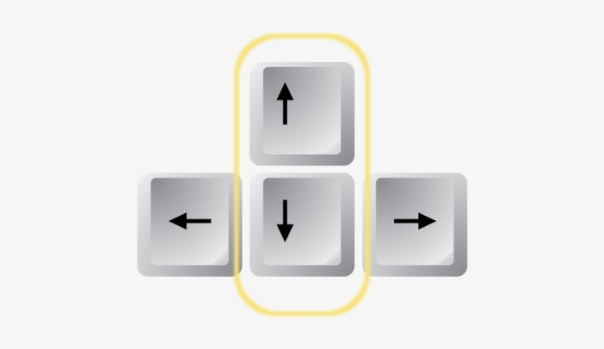
General tips
Saving output from Linux commands/scripts:
Linux CLI: command 2>&1 | tee outputfile.txt
Use the up and down arrow keys on your keyboard to quickly scroll up and down in your command history.

Slide 5
Virtual networks in Linux
Network namespaces are used to create a virtual network for the exercise:
Scripts in the /home/user/C34351MQTT directory
Follow instructions in the exercise document to install the software and scripts
netgenerate.sh - Generates a virtual network
Execute: sudo ./netgenerate.sh
Generates the virtual network on the right and opens an Xterm window on each host
Options:
--noxterms Generates the network but doesn’t open Xterm windows
--numhosts <N> Generates a network with N hosts instead of 3.
clearnet.sh - Deletes the virtual network
Execute: sudo ./clearnet.sh

Slide 6
MQTT Software
Based on the Eclipse Mosquitto broker and clients (https://mosquitto.org)
Website includes documentation that you will need, e.g., command line arguments for
mosquitto - The broker
mosquitto_pub - A publisher client
mosquitto_sub - A subscriber client

Slide 7
Assignment
Go through the steps of the MQTT-CoAP exercise document on Learn
MQTT is the focus of Part 1
Write an lab journal where you answer the questions in the manual
You don’t need to write a loooooong novel for each part
But your answers must be documented!
Continue with Part 2 next week (focus on CoAP), adding to your lab journal
Hand-in the complete lab journal on Learn no later than April 3 @ 23:59.

